Slide 1
Exp set
Yizhou Liu
2.7

Slide 2
Now’s probelm –Who can save
Swin-Transformer? –also find it has an updated version, combined with convolution, also worth trying, will check the detail.
Resnet with regularzation?
More data –Per tumor?

Slide 3
Method
For transformer, padding + crop:
Drop out
Weight decay
Per tumor--- Find a threshold size to filter “predictable tumor”?
For resnet10
Weight decay
Dropout might not be suitable, but found dropblock which I can use in resnet (done). (https://arxiv.org/abs/1810.12890)

Slide 4
Problems
If per tumor:
Some tumor only have several slices, if I need to add extra slices, this would include other tumors.
Some tumor slices are overlapped. –eg: tumor1 slice range:(20,30),tumor2 slice range(26,30)

Slide 5
Possible solution
problem | Solution | Cons | Pros
Some tumor slices are overlapped –eg: one patient has 3 tumors, ranges are (1,15),(18,28),(24,30) | Include slices that are overlapped, treat it like a single tumor – eg: (1,15),(18,30) Creat a smaller bounding box(not fixed size) for each tumor instead of the whole liver | 1. Slices may have multiple tumors 2. This May lose some information of liver | 1. can add some slices for one tumor 2. Can better make sure all the bounding box include a single tumor
For one tumor, only have several slices | Resample to 0.5 mm? (..Not sure) Can expand based on per patient –eg: first include overlapped slices, then expand to adjancet slices: (1,15),(18,28),(24,30) →(1,15),(18,30) →(1,18),(18,30); for lower bound and upper bound can add extra slices eg: (18,30) →(18,30+10) | Not sure if it is reasonable but then the size would be ideal Enlarge slices range, and better take advantage of thoses middle slices between two tumors. | More ideal size Complex for pre-processing but can also implement

Slide 6
Another
Noticed that some overlapped tumors are small, and with few slices. so maybe also can set a relative threshold(medium, or quantile…) to filter some “large tumors”?

Slide 7
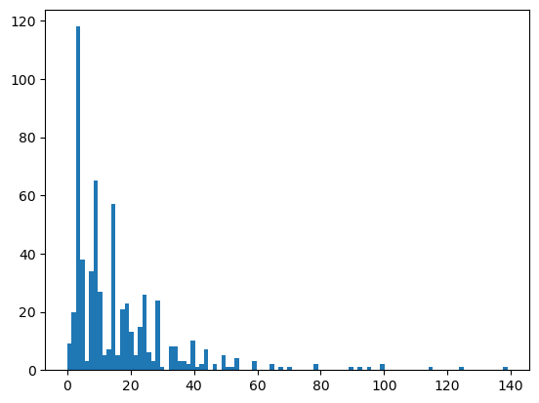
Example
First extract each single tumor –>resample to (0.7,0.7,1)→extract each component as a single tumor
Include overlapped slices as a single tumor (599 tumors)—> eg:(1,15),(16,20),(17,26)→(1,15),(16,26)
Crop with liver bounding box and each tumor’s slices range
Resample to 0.74,0.74,1 mm
Slices plot

Slide 8
Exps set
Data | Model | Input | Status
Largest | Resnet10 | DA | Done
Largest | Swin-transformer | DA | Not yet
Largest | Resnet10 | DA+Dropblock | Not yet
Largest | Resnet10 | DA+fewer feature maps | Not yet
Largest | Swin-transformer | Dropout | Not yet
Per tumor | Resnet10 |  | TBD
Per tumor | Swin-transformer |  | TBD
For resnet, input raw data; For Swin-transformer, padding with Crop to (256,256,64)
For the parameters will do some pre-exps to see if it works.
Per tumor is still to be decided how to extract.

